Slide 1

Explore Only Approach
Presented by:
Elizer Ponio Jr.

Slide 2
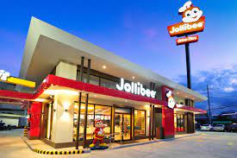
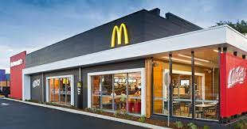
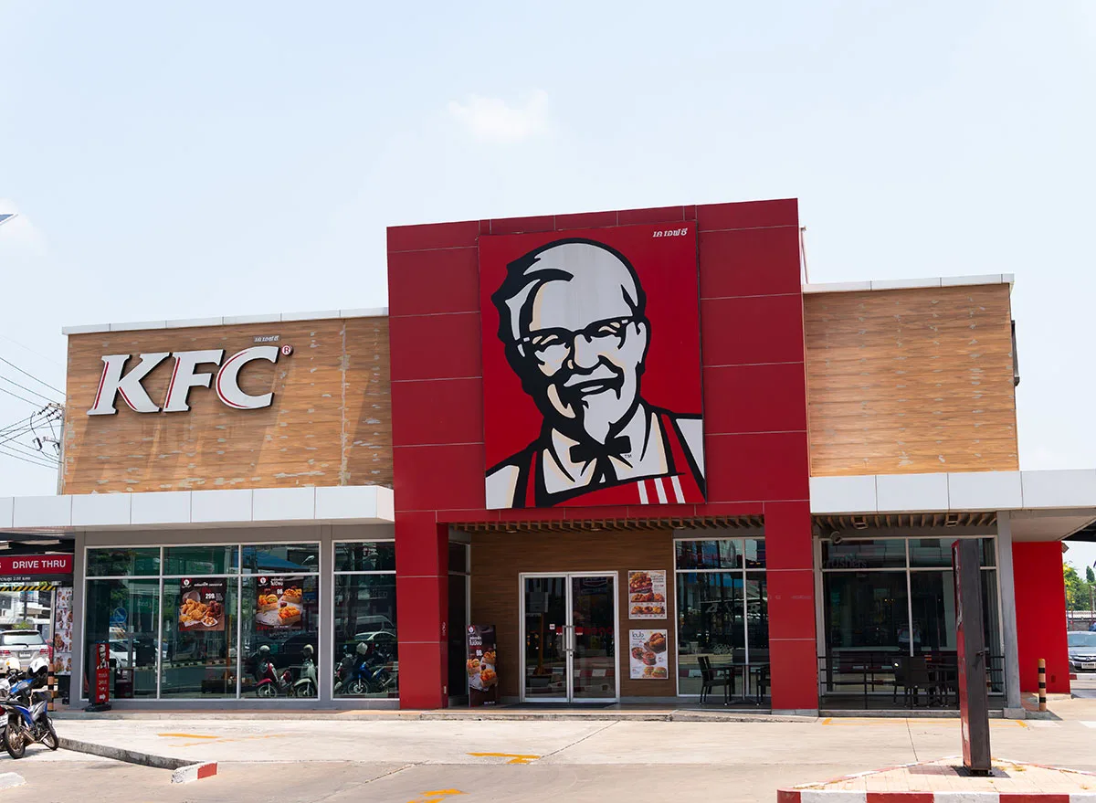

You

Slide 3
You are given 300 days and your task is to find out which restaurant has the
highest average happiness/satisfaction rating!

Slide 4
μ = 10
σ = 5
μ = 8
σ = 4
μ = 5
σ = 2.5
Let us assume that you do not know the average rating/happiness of each restaurant

Slide 5
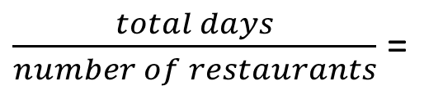
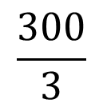
100 visits
100 visits
100 visits
In explore only approach, you will visit each restaurant 100 times
$\frac{total days}{number of restaurants}$ =
$$\frac{300}{3}$$
= 100

Slide 6
Calculate the total regret ρ (Rho)
ρ = maximum happiness - average happiness

Slide 7
Mean happiness (μ) = 10
Times visited = 100
Mean happiness (μ) = 8
Times visited = 100
Mean happiness (μ) = 5
Times visited = 100
Calculate average happiness
100 (10) + 100 (8) + 100 (5)
1000 + 800 + 500 = 2300

Slide 8
Maximum happiness or Optimal happiness is the value assuming that you already know which restaurant has the highest average/mean happiness and you went to that restaurant for 300 days
10 x 300 = 3000

Slide 9
Calculate regret
ρ = 3000 – 2300
ρ = 700

